Slide 1
Intel Maker’s ESP32 course – by intel’s makers community class 2
Gil Tal.
May 2021

Slide 3
Class 2 agenda:
I/Os electrical types
I/Os types
I/O matrix and device mapping
Device \ Unit driver types and usage
Graphics fundamentals
The LCD we have on our platform
TV out
Flash memory vs EPROM
SPIFFS
SD card and FAT32 usage
Write a driver for the DC motors device (DRV8833)

Slide 4
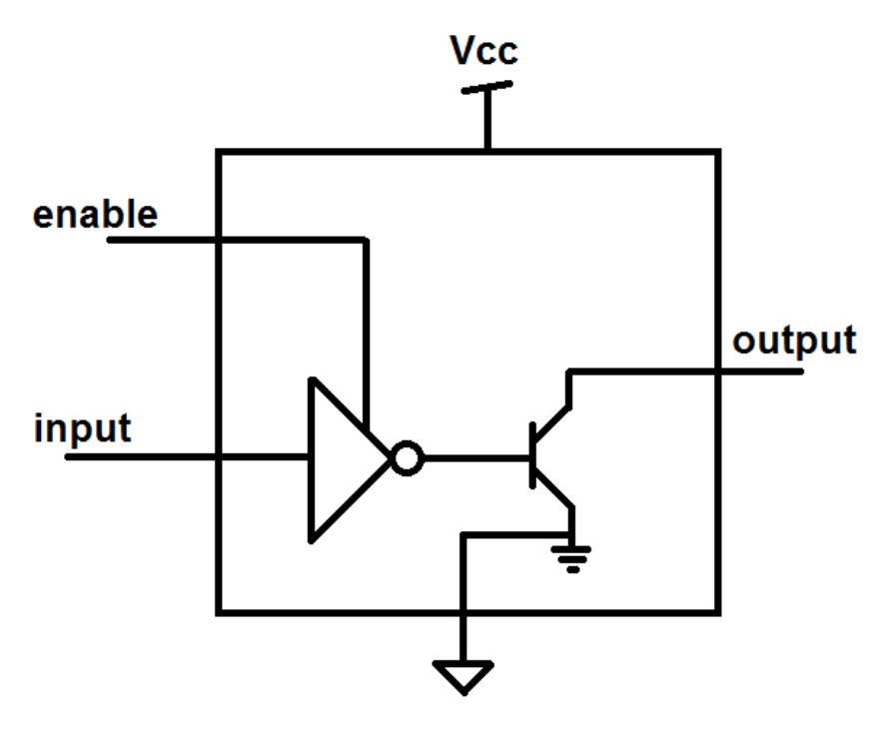
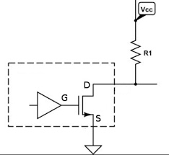
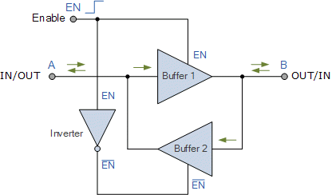
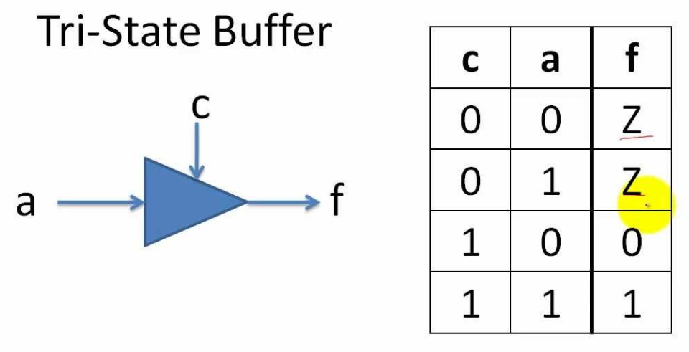
Open drain buffer: Either drives ground or float the output
A pull up resistor is needed to drive logic 1
Bi-Directional I/O
Tri state buffer:

Slide 5
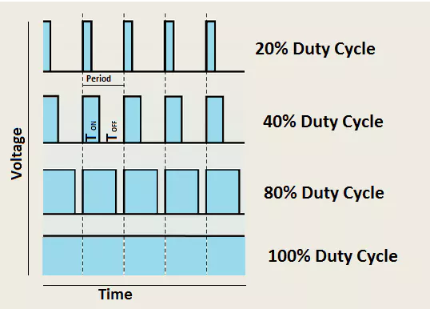
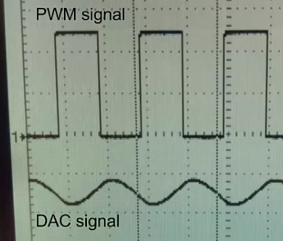
I/O and the different types
Digital type:
Setup: pinMode(34 /* IO Number */, INPUT);
Setup: pinMode(34 /* IO Number */, OUTPUT);
digitalWrite(34, HIGH); digitalWrite(34, LOW);
digitalRead(34);
Analog type:
Setup: pinMode(36, ANALOG) // Input only
analogRead(36);
PWM (Pulse-Width Modulation):
Setup: pinMode(25, OUTPUT);
Setup: ledcSetup(1/*Channel*/, 2000/*Freq*/, 8/*Number of bits for resolution of duty cycle*/);
Setup: ledcAttachPin(25, 1);
ledcWriteTone(1/*Channel*/, 2000/*Freq*/);
ledcWrite(1/*Channel*/, 196 /*Duty Cycle*/);
DAC:
No setup needed
dacWrite(25,Value /* 0 – 255 */); // Output 0-3.3V, 0.013V steps

Slide 6
I/O and the different types
Digital type:
Setup: pinMode(34 /* IO Number */, INPUT);
Setup: pinMode(34 /* IO Number */, OUTPUT);
Setup: pinMode(34 /* IO Number */, INPUT_PULLUP);
Setup: pinMode(34 /* IO Number */, INPUT_PULLDOWN);
Setup: pinMode(34 /* IO Number */, OUTPUT_OPEN_DRAIN);
digitalWrite(34, HIGH);
digitalWrite(34, LOW);
digitalRead(34);
Analog type:
Setup: pinMode(36, ANALOG) // Input only
analogRead(36);

Slide 7
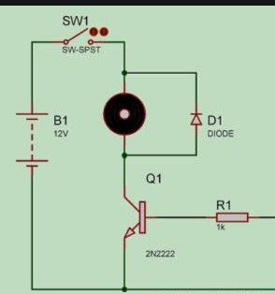
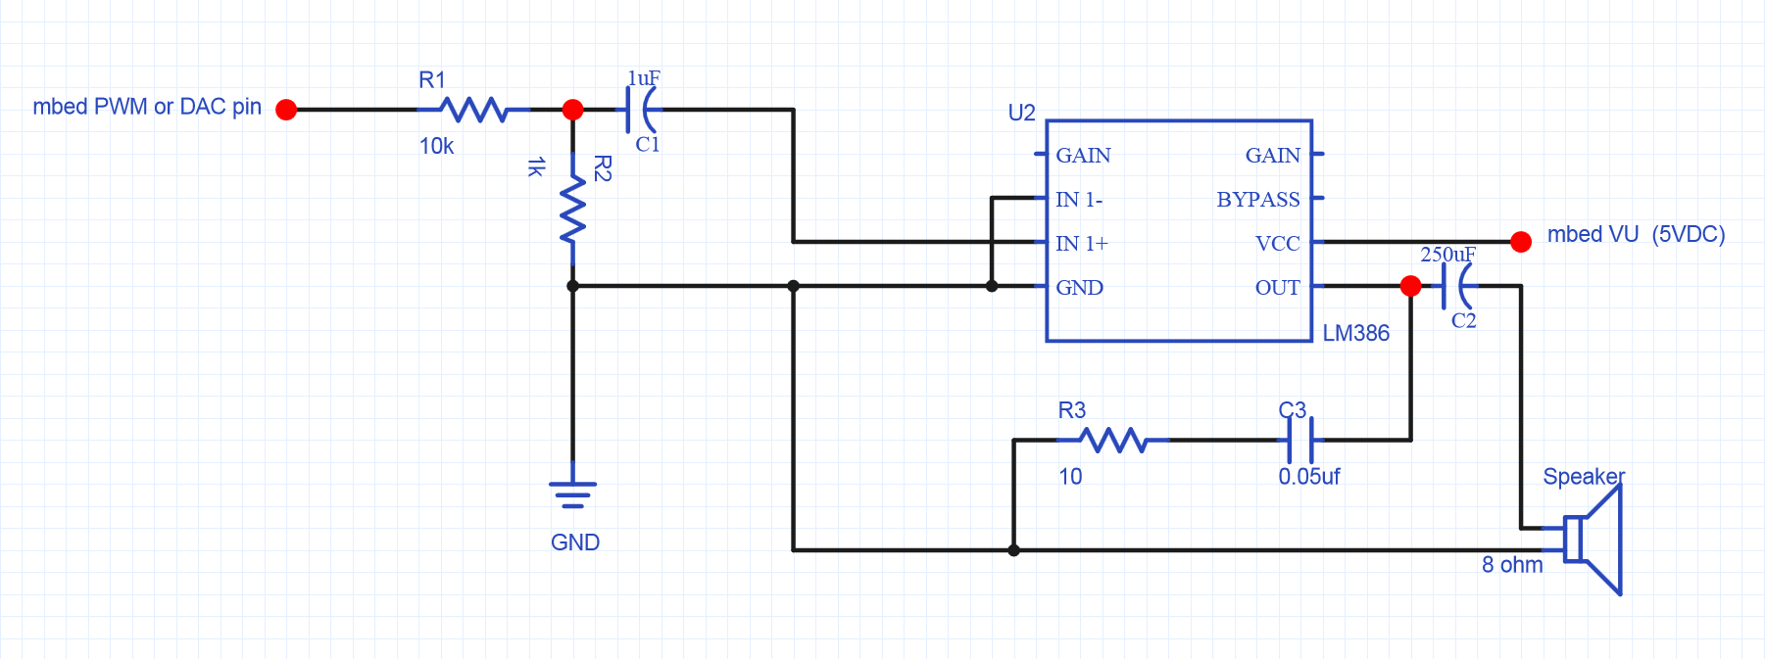
Usage for i/os
Digital: Control led, relays, read state of digital inputs coming from different devices
Analog: Read voltage level of a device, potentiometer, Joy Stick
PWM: Control a speaker, DC motors, servo electric engines and more…
DAC: Drive a speaker with volume control, generate special wave forms, use your imagination
PWM

Slide 8
I/O matrix and device mapping
Some units have fixed IO mapping
Most micro controllers have IO matrix for greater flexibility
Some options might have frequency limitations

Slide 9
Before connecting a device…
We need to figure out:
Physical connection (either by watching the schematic, detailed board diagram or any other document with the relevant data)
What interface\protocol is used by the device, need to make sure we have a free one
What is the frequency the device can operate
Voltage level – both I/O and supply
Total power consumption
Does it have additional signals needed beside what the protocol defines
Does it need a pull up or pull down on part of the signals?

Slide 10
Mapping the LCD of our platform
In general mistakes in connectivity can damage a board!
Information for physical connectivity must be available for us
Interface used by the LCD is SPI:
MOSI – Master out slave in (drive data from ESP32 to the LCD)
Clock
CS – Chip Select
Reset
Out of spec signal - CMD\Data , distinguish between data or command transaction
Information for the specific I/Os used is in the schematic of the ESP32 TTGO module
Graphics.h is a general LCD\TV out driver that supports the platform’s ST7789 device
Small porting is needed

Slide 11
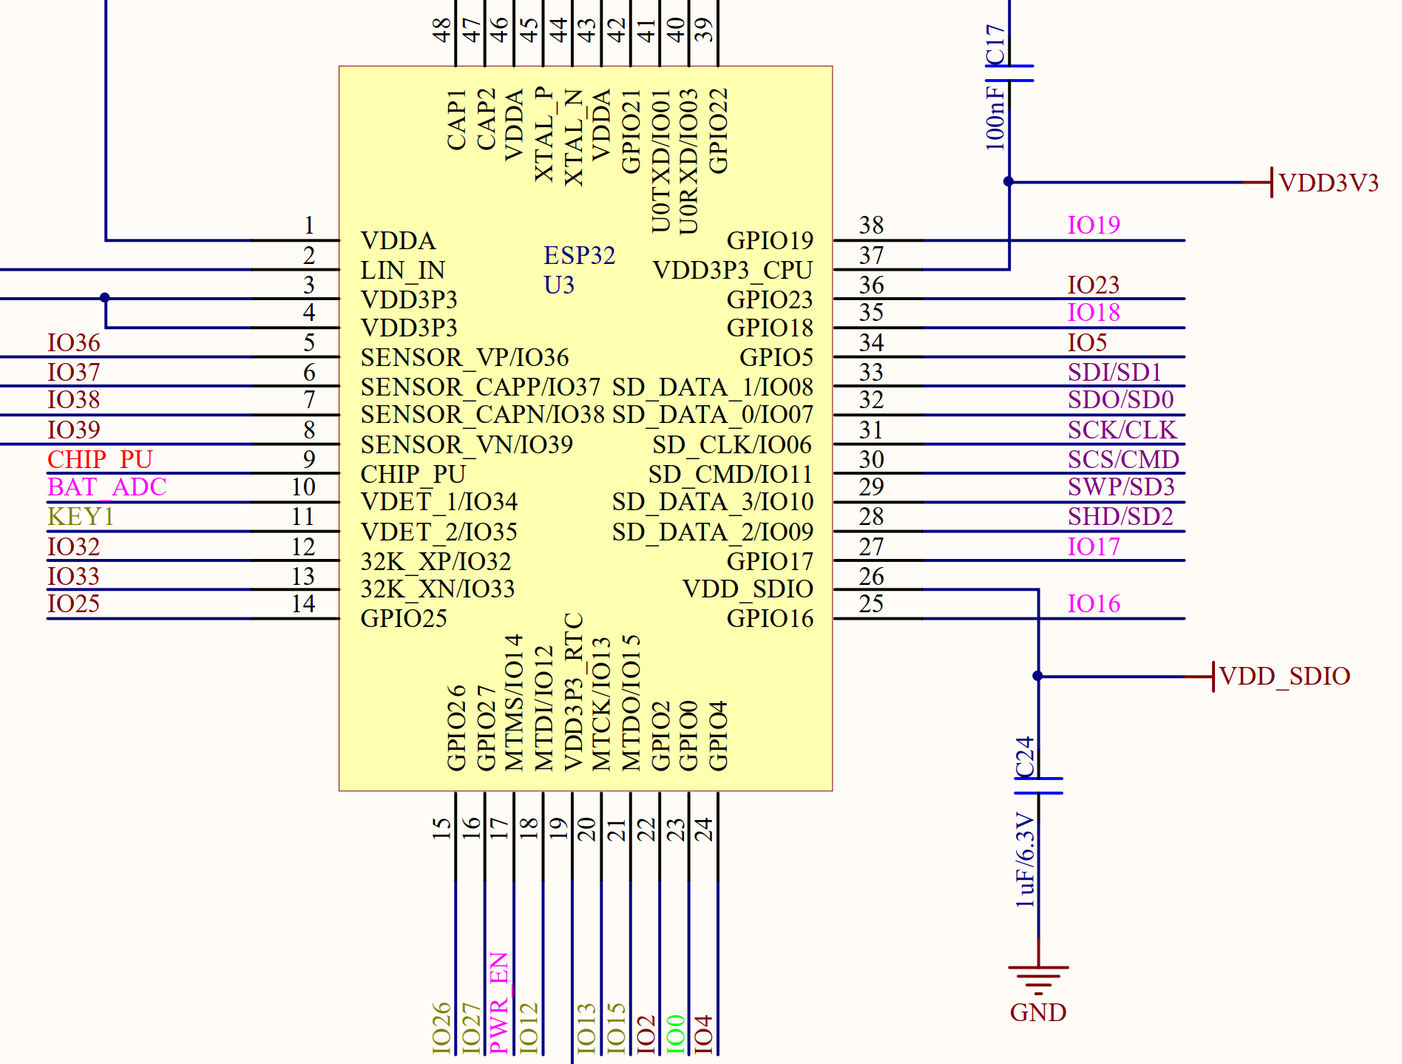
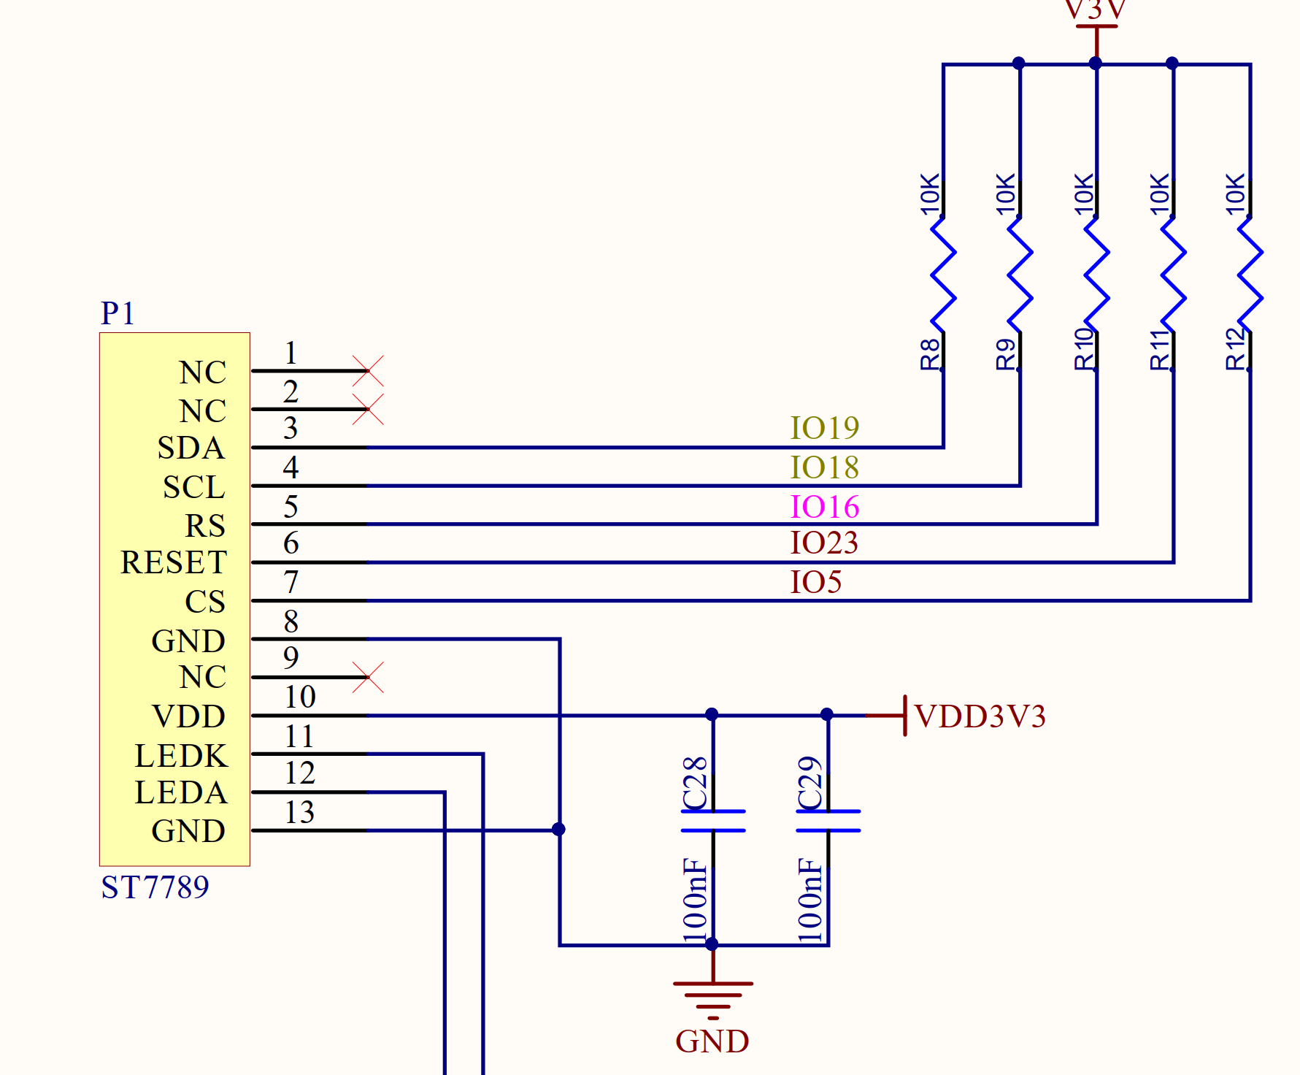
ESP32 TTGO module schematic
ESP32
SPI-MOSI
SPI Clock
Data\CMD
Chip Select

Slide 12
Device driver
Device Driver
Micro Controller
(ESP32)
Enable us to:
Utilize the device’s capabilities
Initialize the device
Device
(LCD for Example)
Device Driver
SW structure
HAL
Hardware Abstraction Layer
User API
Application Programming Interface

Slide 13
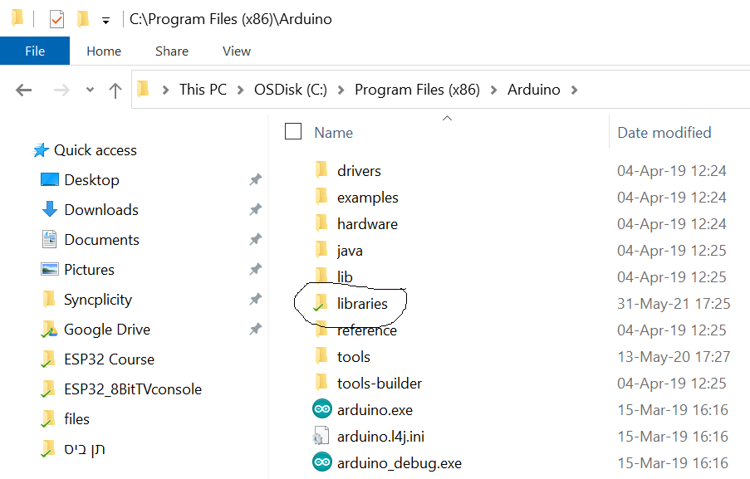
Getting started with a driver
When using a driver for the first time:
We need to place the driver in the library Arduino folder
We might need to do a small porting or adaptations
Types of adaptions we might face:
The simplest one is just providing basic parameters such as:
I\O pins mapping
I2C address
Unit index (in case we have multiple instances of the same unit)
Next will need a background task or an interrupt service routine
In most cases an example is provided
A More complicated one will need an accessor - meaning:
We will need to inherent a C++ class and link\implement HAL functions
I will go through an example

Slide 14
HAL \ API
HAL (direct HW access):
Used by the driver internally
SPI interface native functions for example
SPI.writeBYTE((char)VAL);
ESP_WRITE_REG(0x3FF4400c, PAR_IOs_MASK);
API (To be used by the programmer ☺):
Graphics driver functions for examples:
fillScr(unsigned char r, unsigned char g, unsigned char b);
drawRoundRect(short x1, short y1, short x2, short y2, bool fill = false);

Slide 15
Our LCD driver as an example - Setup
Driver uses VSPI (ESP32 has two SPI controllers available for the user – VSPI and HSPI)
// HAL - graphics.h
#define ST77XXSPI_DATA_COMMAND_PIN 16
#define ST77XXSPI_CS_PIN 5
#define ST77XXSPI_RESET_PIN 23
#define ST77XXSPI_MOSI_PIN 19
#define ST77XXSPI_CLK_PIN 18
// Main
#include "graphics.h“
ST77XX lcd(_240x135);
setup()
{
lcd.init(40000000);
}
loop()
{
lcd.fillScr(0, 0, 0);
lcd.setColor(0, 255, 0);
lcd.drawRect(0, 0, lcd.getXSize() - 1, lcd.getYSize() - 1);
}

Slide 16
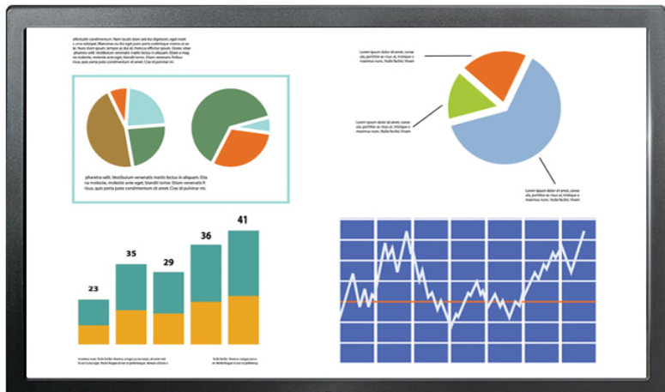
Basic graphics controller
Graphics
Memory
RGB
Graphics controller
(In our case – ST7789)
Interface to host
PCIe, SPI, I2C,UART, Parallel …
Memory structure:
Array of: RGB,RGB,RGB …. Or (ARGB,ARGB,ARGB…)
32, 24, 18, 16, or 3 bit per pixel (8888, 888, 666, 565, 111)

Slide 17
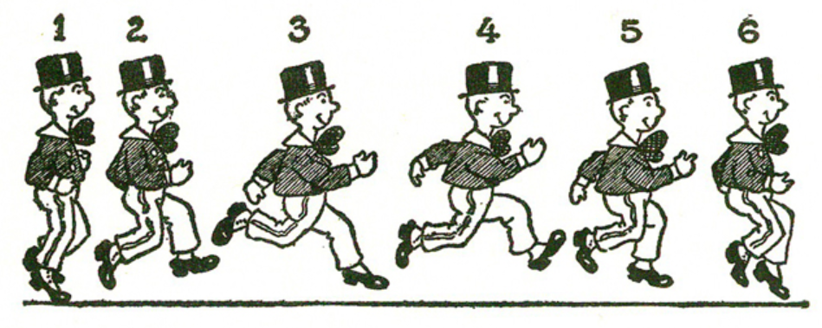
Animation basics…

Slide 18
Few main technics
Option 1: Use one frame, just erase and draw what ever is needed, do it fast enough and it will look OK
Option 2: Use a scratch frame buffer, for each scene:
Erase the frame buffer
Draw the new scene
Send the new scene to the video controller
We need a frame rate greater than 30 to have smooth animation
Option 3: Combination of options 1 and 2
Use frame buffer
just erase and draw what ever is needed
Send the frame to the video controller

Slide 19
Our LCD – ST7789 based
SPI running at 40MHz one bit, with additional Command\Data control
Resolution: 240x135 or 135x240
RGB565 (64K colors): 72 FPS for full screen refresh
Two bytes per pixel

Slide 20
ESP32 and the LCD\TV out block diagram
RGB565 mode – Any write of the graphics drivers access the frame buffer memory directly
ESP32
ST7789
LCD
SPI
Optional Local Frame buffer
Memory
Frame buffer
Memory
TV Out mode – Any write of the graphics drivers access the local frame buffer
At any time one frame buffer is active and the second is being refreshed directly to the TV
ESP32
TV
Local Frame buffer
Memory 0
DAC25
Local Frame buffer
Memory 1

Slide 21
TV Out – Uses DAC25 and I2S0
#include "graphics.h"
TVout tvOut;
void compositeCore(void *data)
{
while (true)
{
tvOut.sendFrame();
}
}
void setup()
{
tvOut.init();
xTaskCreatePinnedToCore(compositeCore, “tvOutTask", 1024, NULL, 1, NULL, 0);
}
void loop()
{
unsigned long time;
tvOut.fillScr(0xff, 0xff, 0xff);
tvOut.loadFonts(ORBITRON_LIGHT32);
tvOut.setColor(0, 0, 0);
tvOut.print("Driver Test...", 0, 100, true);
tvOut.setColor(0xff, 0x00, 0x00);
tvOut.drawCircle(50, 200, 20, true);
tvOut.setColor(0x00, 0xff, 0x00);
tvOut.drawCircle(100, 200, 20, true);
tvOut.setColor(0x00, 0x00, 0xff);
tvOut.drawCircle(150, 200, 20, true);
tvOut.swapFrameBuffers();
while (1);
}

Slide 22
Generating bitmaps and using them in our code
Pick your image, make it a BMP file with size no larger than 240x135
Use the BMPconverter.exe in the tools directory in the GIT
The tool generates a C file containing the array (bitmap)
Place the file in your project directory as is
Generate a declaration in your main file (where loop resides)
extern const unsigned char/unsigned int/unsigned short FlappyBird[];
LCD.drawCompressed24bitBitmap(x,y, FlappyBird);

Slide 23
Interrupt driven driver – Led Matrix
#include <SPI.h>
#include "LedMatrix.h"
const char latchPin = 0;
const char en_74138 = 16;
const char la_74138 = 100; // Use value of 100 for shift rgister implementation of the la,lb,lc,ld pins
const char lb_74138 = 100; // Not used
const char lc_74138 = 100; // Not used
const char ld_74138 = 100; // Not used
const char le_74138 = 100; // Not used
#define TIMER_INTERVAL 6250
RedLEDmatrix matrix(latchPin, en_74138, la_74138, lb_74138, lc_74138, ld_74138,le_74138);
void ICACHE_RAM_ATTR onTimerISR()
{
matrix.shiftOutRow();
}
void setup()
{
//Initialize Ticker for Matrix
timer1_attachInterrupt(onTimerISR);
timer1_enable(TIM_DIV16, TIM_EDGE, TIM_LOOP);
timer1_write(TIMER_INTERVAL); // 5MHz/800 (16*50) = 6250 (50 frames per second)
ESP.wdtEnable(8000);
}
void loop()
{
matrix.clrScr();
matrix.setColor(RED_COLOR);
matrix.drawLine(0, 0, 63, 15);
matrix.swapFrameBuffer();
while (1)
{
ESP.wdtFeed();
}
}

Slide 24
Accessor based driver
#include "driver/uart.h"
#include "CH559.h“
class ch559uartAcc : public UARTaccessor
{
public:
ch559uartAcc() {};
~ch559uartAcc() {};
bool init()
{
Serial1.begin(1000000, SERIAL_8N1, 19, 23);
Serial1.setRxBufferSize(128);
return true;
}
int available()
{
return Serial1.available();
}
int read()
{
return Serial1.read();
}
void write(unsigned char c)
{
Serial1.write(c);
}
};
HIDdevice hidDevice;
ch559uartAcc ch559accessor;
CH559 ch559port(&ch559accessor);
void setup(void)
{
ch559port.init();
delay(100);
}
void loop()
{
if (ch559port.update(&hidDevice))
{
// Use the data in hidDevice
}
}

Slide 25
Flash memory
Non volatile programable memory
Most common interface is SPI (1,4 or 8 bits)
Sector based (4KB, 8KB, 16KB, 64KB, 128KB) – ESP32’s flash sector size is 4KB
After erase the state of all erased bits is logic 1(0xFFFFFFFF)
We can set any bit to 0, but cannot set it back to 1 unless we erase a complete sector
Sector can be erased around 100000 times!! That’s all!!
Erase operation is long (~10ms)
Not suitable serving a memory for counters (will stop functioning after 100000 time!)
Sectors can be protected

Slide 26
EEprom memory
Small sizes (2KB to 64KB)
Size to price ratio is bad ☹
You can just write to any byte any data
Most common interface is I2C
Very slow and mostly used for saving configuration data
ESP32’s EEPROM is emulated on the main flash and is occupying one sector (4KB)
How to use:
EEPROM.begin(512); // Size up to 4096
EEPROM.write(12/*Address*/,100/*Data*/);
EEPROM.commit(); // Save the data

Slide 27
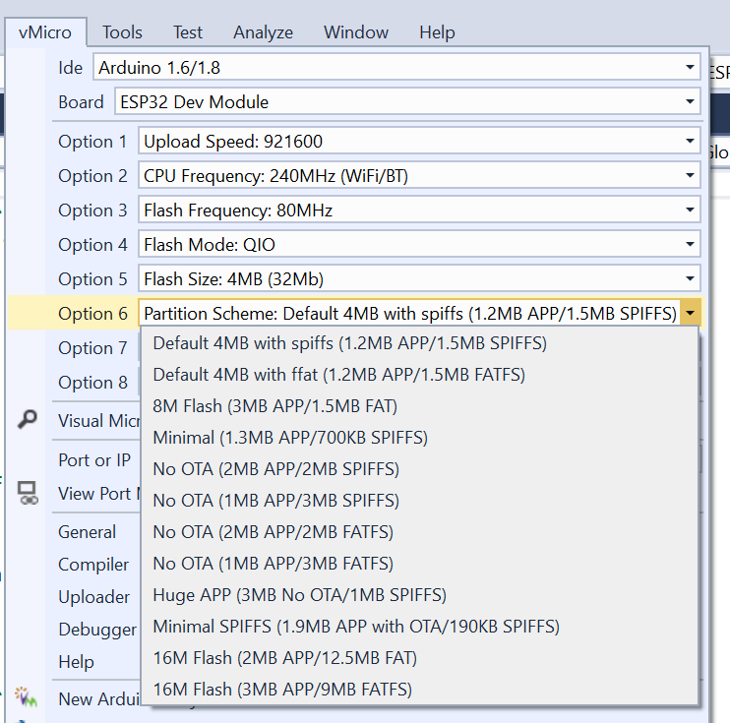
ESP32 Flash memory Partitions
Partition table is flexible
Can be set through visual micro
Application partition 1
1.2MB
Application partition 2
1.2MB
SPIFFS
1.5MB

Slide 28
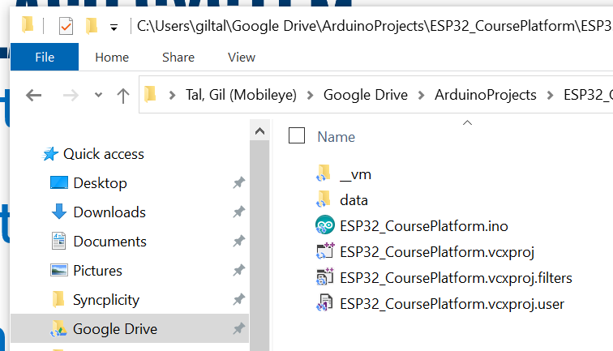
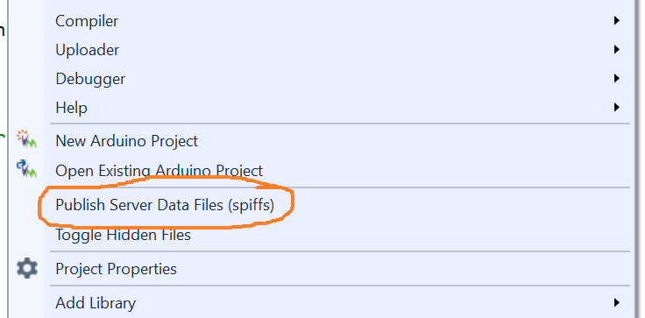
SPIFFS – SPI flash system
Resides on the ESP32’s flash memory
Create a data folder in the sketch folder
Upload it through visual micro
Files accessible in our code
Look @ ESP32_SPIFFSdemo.ino
Copy the data folder into sketch folder

Slide 29
SD Card
Our platform is equipped with a micro-SD card slot
Just format a micro-SD card as FAT32
Place your files
Insert the card into the platform
Look @ ESP32_SDcardDemo.ino
The pins setup is taken from the block diagram of our platform

Slide 30
Coding our own driver – DRV8833
Device data sheet / spec is needed
First, we need to understand what are the device features?
Second, we need to understand what protocol it uses?
Need to decide what type of driver is it going to be?
Simple initialization setup?
Interrupt driven?
Does it need an accessor? Complex but most flexible
Does it need a background process?

Slide 31
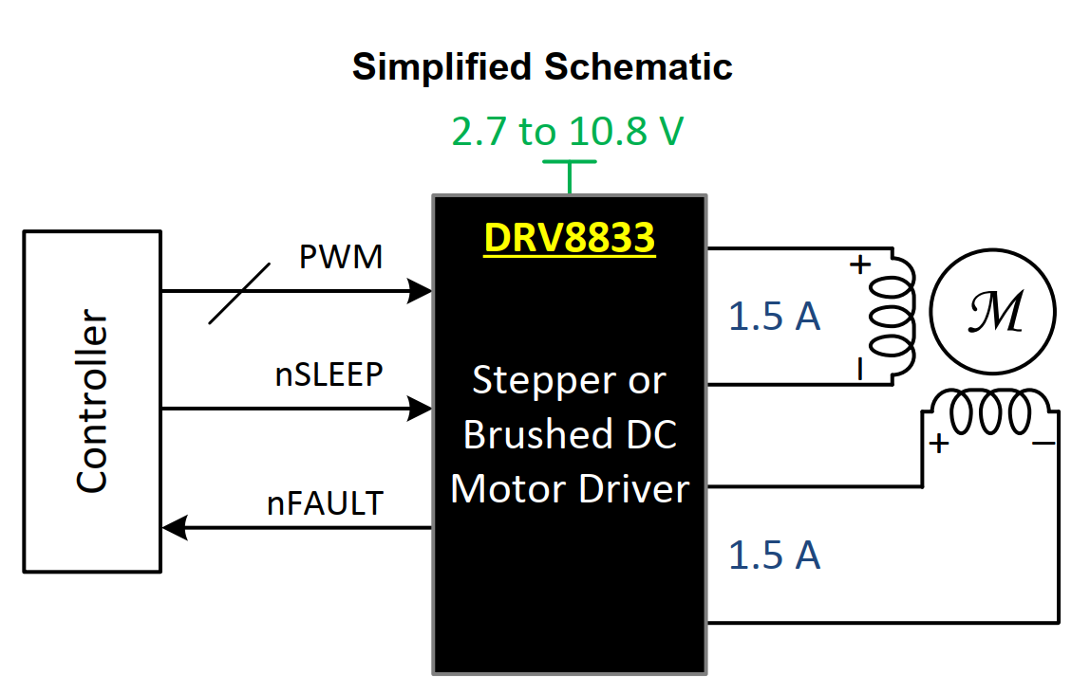
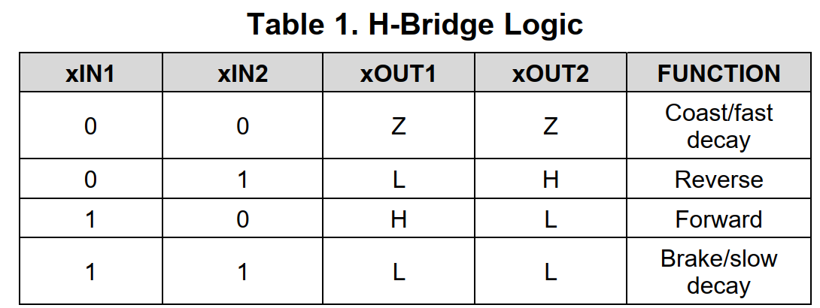
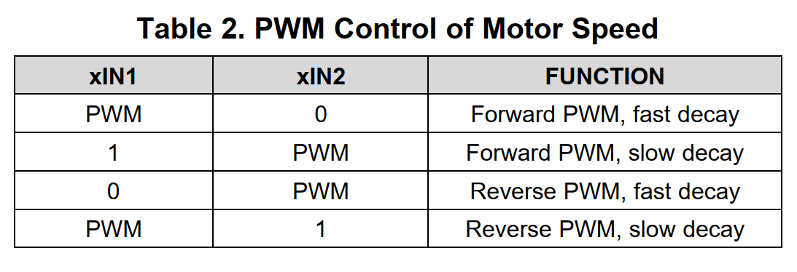
DRV8833
2 DC motors drivers or 1 step motor
Gives control for direction
1.5-A RMS, 2-A Peak per H-Bridge in PWP

Slide 32
The speaker (buzzer)
Uses PWM channel 0
Has two functions:
One blocking: void sound(unsigned short freq, unsigned short timeInMilliSec);
Will play sound of frequency for a period of time, when done will return
Second non blocking: void sound(unsigned short freq);
Will trigger the speaker to generate sound at specified frequency and return immediately
Call: soundOff(); to shut off the speaker

